Slide 1


K. RAMAKRISHNAN COLLEGE OF ENGINEERING
(AUTONOMOUS), SAMAYAPURAM – TRICHY
DEPARTMENT OF CSE(ARTIFICIAL INTELLIGENCE AND MACHINE LEARNING)
CGB1221 – DATABASE MANAGEMENT SYSTEMS
MINI GITHUB
PRESENTED BY SUPERVISOR
BALAMANIKANDAN S Mr. P.Nagaraj, M.E.,
8115U24AM013 Assistant Professor / AI&ML.

Slide 2
PRESENTATION OVERVIEW
Objective
Project Analysis
System Architecture
Methodology
Dataset Used
Modules
Implementation
Conclusion
Future Scope

Slide 3
OBJECTIVE
To design and implement a relational database that models a simplified GitHub system with entities like User, Repository, Commit, and Issue.
To apply core DBMS concepts such as ER modeling, normalization, primary and foreign keys, and constraints to ensure data integrity and reduce redundancy.
To demonstrate how structured queries (SQL) can be used to manage, retrieve, and maintain version control and collaboration data efficiently

Slide 4
PROJECT ANALYSIS
Complexity in using Git commands (branching, merging, rebasing)
Difficulty for beginners due to steep learning curve
Merge conflicts when multiple users edit the same code
Challenges in team collaboration and communication

Slide 5
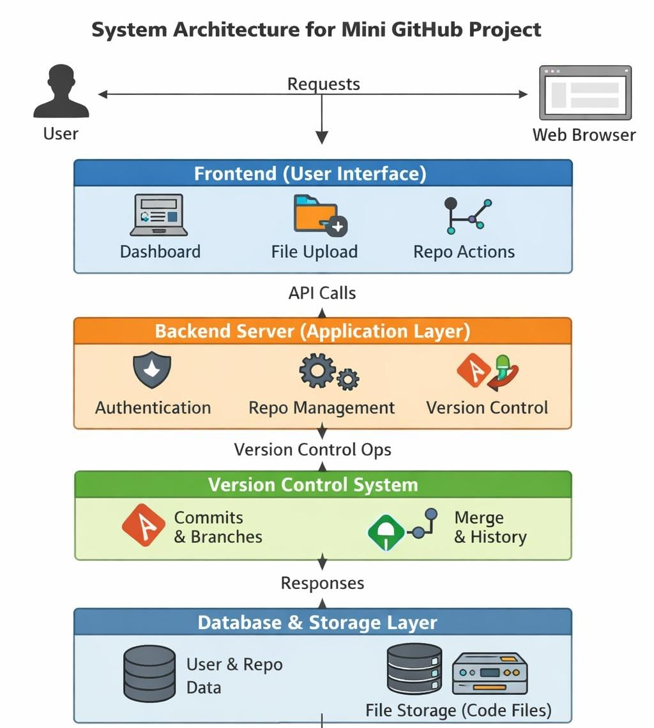
SYSTEM ARCHITECTURE

Slide 6
METHODOLOGY
Requirement Gathering
Analyze functional and non-functional requirements.
System Design
Create UI/UX design for user interaction.
Development
Monitor and maintain the system.
Testing
Debug errors and ensure system reliability.

Slide 7
DATASET USED
User Dataset
Stores user details like username, email, and password
Repository Dataset
Contains information about repositories such as name, owner, and visibility
Commit Dataset
Maintains history of code changes with commit messages and timestamps
File Dataset
Stores files and their versions within repositories
Branch Dataset
Keeps track of different branches in a repository

Slide 8
MODULES
User Module:
Handles user registration, login, and profile management
Repository Module:
Manages creation, deletion, and organization of repositories
Version Control Module:
Tracks code changes using commits, branches, and merges
File Management Module:
Handles uploading, editing, and deletion of files
Notification Module:
Sends alerts for commits, pull requests, and issues

Slide 9
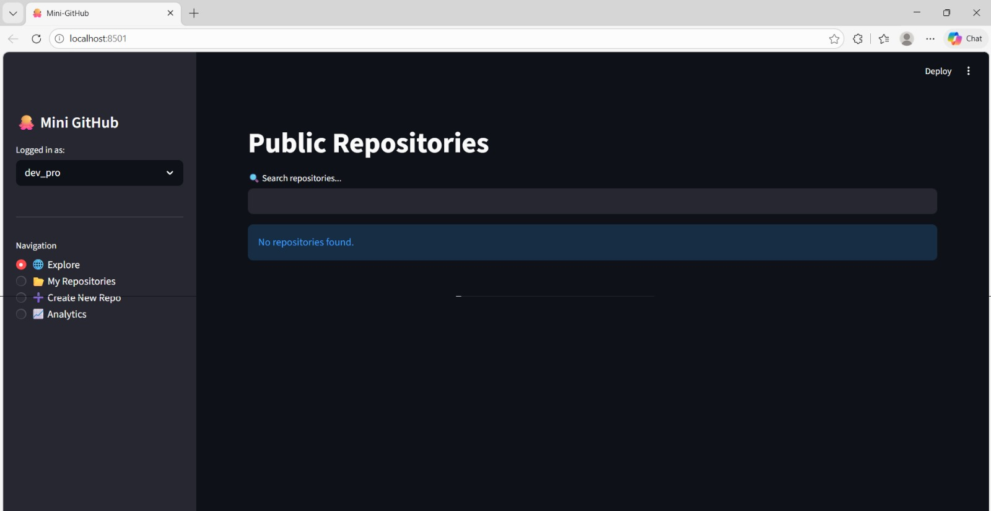
IMPLEMENTATION

Slide 10
CONCLUSION
It provides a practical understanding of real-world software development workflows
It enables users to manage repositories, track code changes, and collaborate efficiently
Core features like commits, branching, and pull requests improve code management
The system enhances teamwork and reduces code conflicts

Slide 11
FUTURE SCOPE
Integration with advanced CI/CD tools for automated testing and deployment
Implementation of AI-based code suggestions and error detection
Enhanced security features like multi-factor authentication
Support for real-time collaboration (live code editing)
Mobile application development for better accessibility
Improved UI/UX for a more user-friendly experience

Slide 12


